Slide 1
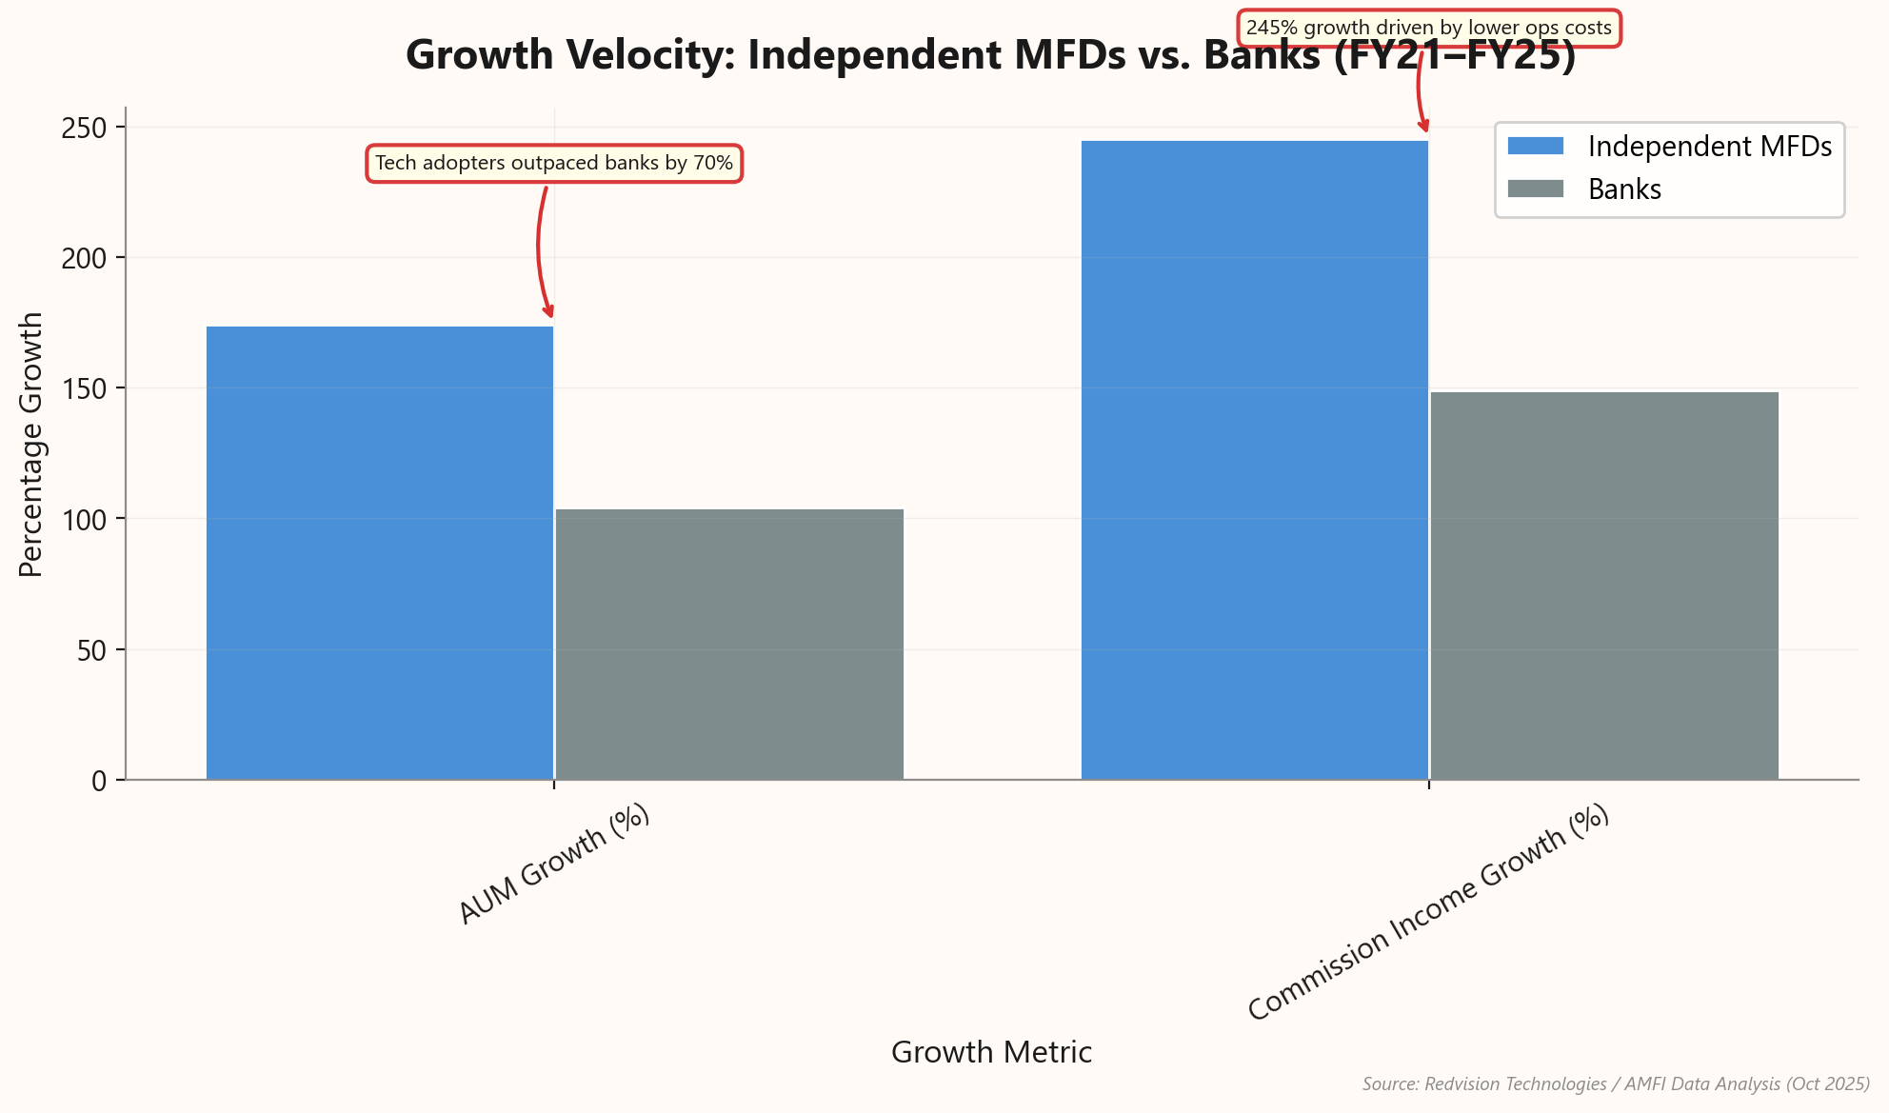
Scaling MFD Practices: Breaking the Linear Growth Trap
▸ Equity AUM grew 10x while MFD workforce grew only 2.5x (2015–2025).
▸ Tech-enabled advisors manage 300+ clients compared to 50–100 in manual models.
▸ Tech-first independent MFDs outpaced banks with 174% AUM growth (FY21–FY25).
▸ Operational efficiency drove a 245% surge in commission income for independent MFDs.
▸ Scalable systems are essential to serve the projected 20 crore investors by 2035.
★ KEY INSIGHT: Client databases allow MFDs to decouple revenue from headcount, breaking the 'Linear Growth Trap.'
Client Databases: The Invisible Engine Behind Scal...
Slide 1 of 7

Slide 2
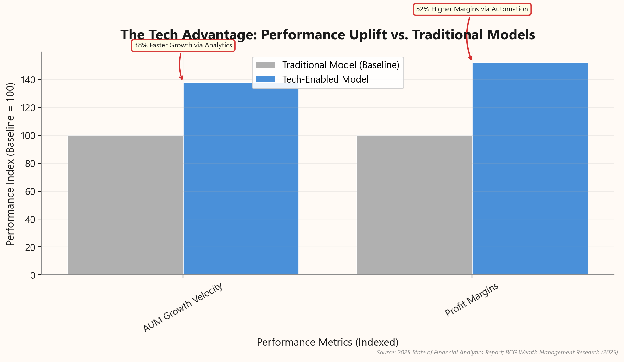
Pivot to Industrial Models to Capture ₹100T Opportunity
▸ Industry AUM projected to reach ₹100 Trillion by 2030, driven by household savings.
▸ Manual "Artisanal" models cannot sustain volume; Jan 2026 added 50.6 lakh new folios.
▸ Tech-enabled firms achieve 52% higher profit margins through operational automation.
▸ Analytics-driven advisors grow AUM 38% faster than the industry average.
▸ Direct Plan AUM grew 43.5% in 2025, necessitating a value-driven service pivot.
★ KEY INSIGHT: To capture the ₹100T opportunity, MFDs must pivot from 'Artisanal' to 'Industrial' models using technology.
Client Databases: The Invisible Engine Behind Scal...
Slide 2 of 7

Slide 3
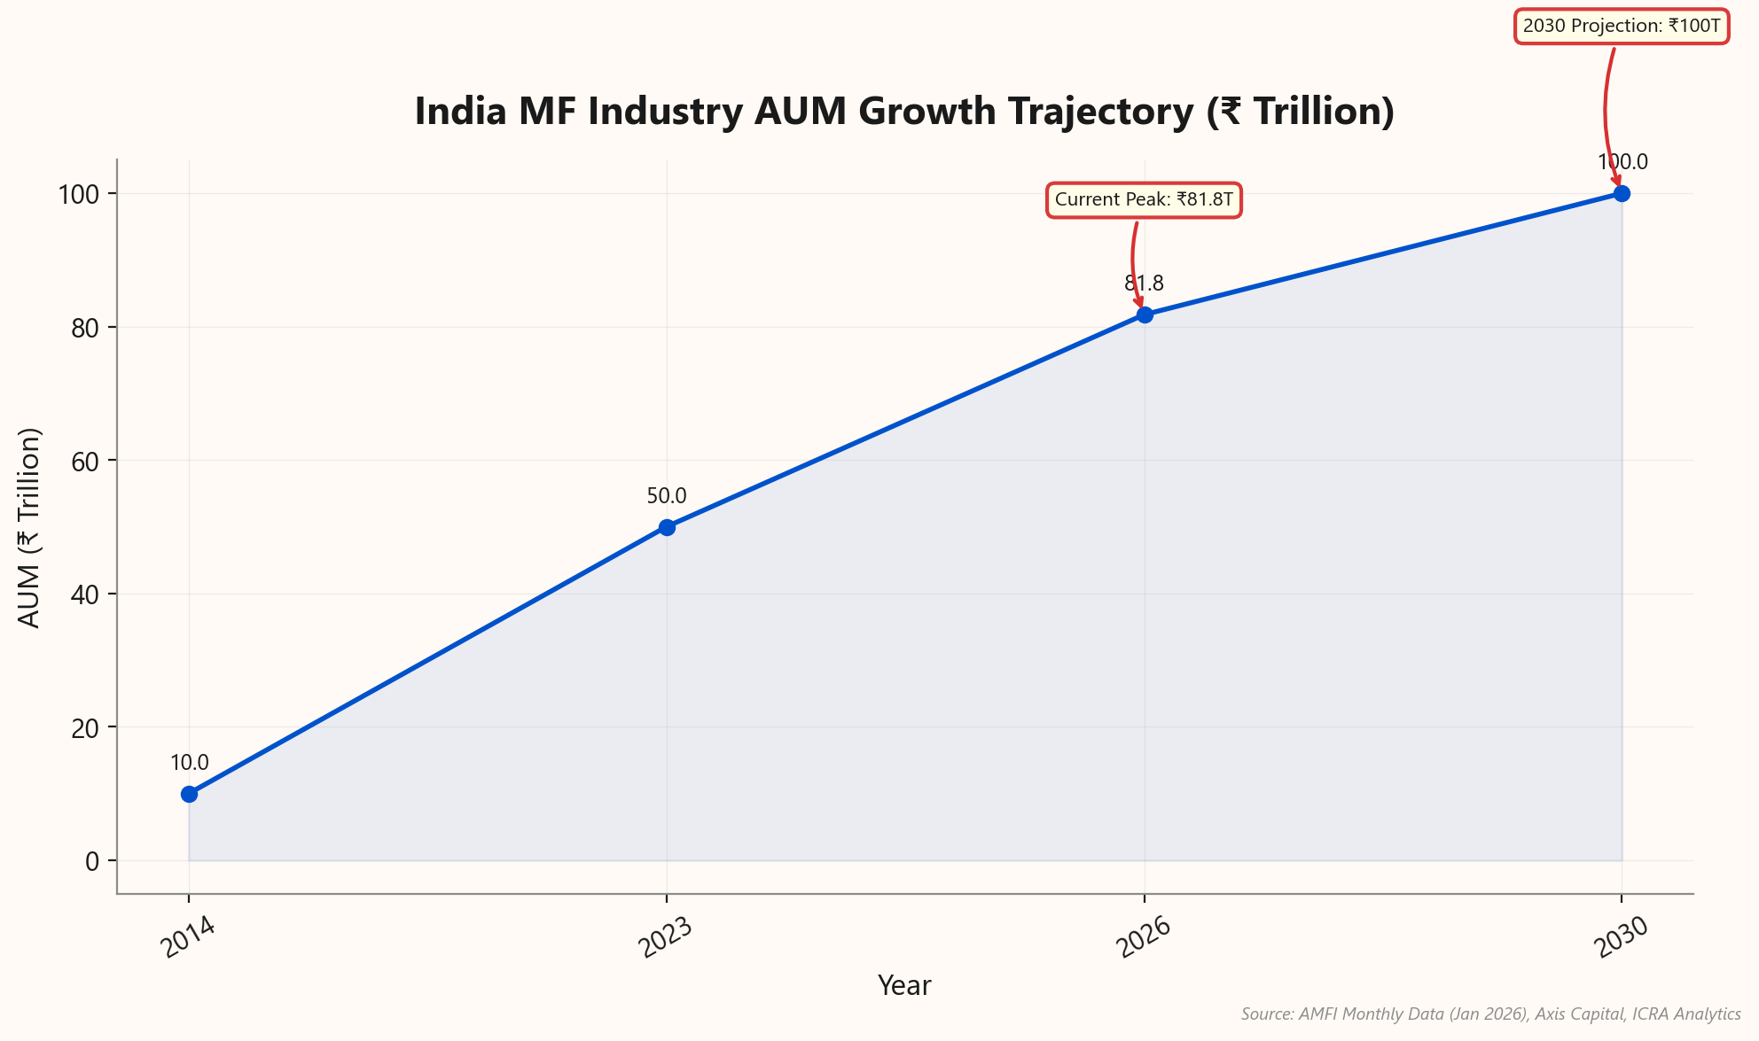
Manual Operations Cannot Withstand the ₹100 Trillion Tsunami
▸ Industry AUM skyrocketed 8x from ₹10T (2014) to ₹81.8T (Jan 2026).
▸ Market trajectory targets ₹100 Trillion by 2030 at ~14-20% CAGR.
▸ Monthly SIP inflows grew 10x to over ₹31,000 Crore.
▸ Volume exceeds 100 million monthly transactions, overwhelming manual ledgers.
▸ Tech-enabled distributors capture 38% faster AUM growth vs. manual peers.
★ KEY INSIGHT: The market is compounding at ~20% CAGR; manual reconciliation cannot withstand the velocity of 100 million monthly transactions.
Client Databases: The Invisible Engine Behind Scal...
Slide 3 of 7

Slide 4
Tech-Enabled Firms Grow Faster and Retain More Earnings
Metric | Traditional Firm | Tech-Enabled Firm | The Tech Advantage
New Asset Growth | Baseline | +68% New Assets | 1.7x Acceleration
Profit Margin (EBOC) | 42% | 66% | +57% Profitability
Revenue Per Advisor | ₹1.5 Cr (Est.) | ₹2.5 Cr+ | ~66% Higher Efficiency
Client Closing Rate | 68% | 73% | +5% Conversion Boost
Sources: Charles Schwab RIA Benchmarking (2025), Fidelity (2024), Kitces (2024)
Client Databases: The Invisible Engine Behind Scal...
Slide 4 of 7

Slide 5
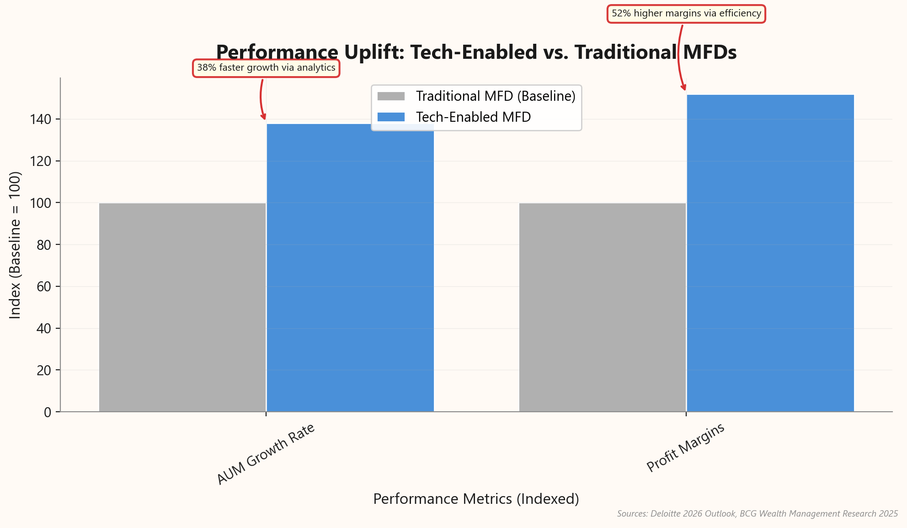
Automating Operations to Unlock Advisory Revenue
▸ Automated platforms save 6.2 hours weekly by eliminating manual data reconciliation.
▸ Streamlines critical workflows: portfolio rebalancing, SIP registration, and KYC compliance.
▸ Seamless RTA integration (CAMS/KFintech) ensures real-time data flow and accuracy.
▸ Shifts focus from back-office administration to high-value front-office relationship mining.
▸ Enables scalability to handle the 17% YoY surge in SIP volumes.
★ KEY INSIGHT: Reclaiming 6.2 hours a week allows advisors to focus on relationship mining, not data entry.
Client Databases: The Invisible Engine Behind Scal...
Slide 5 of 7

Slide 6
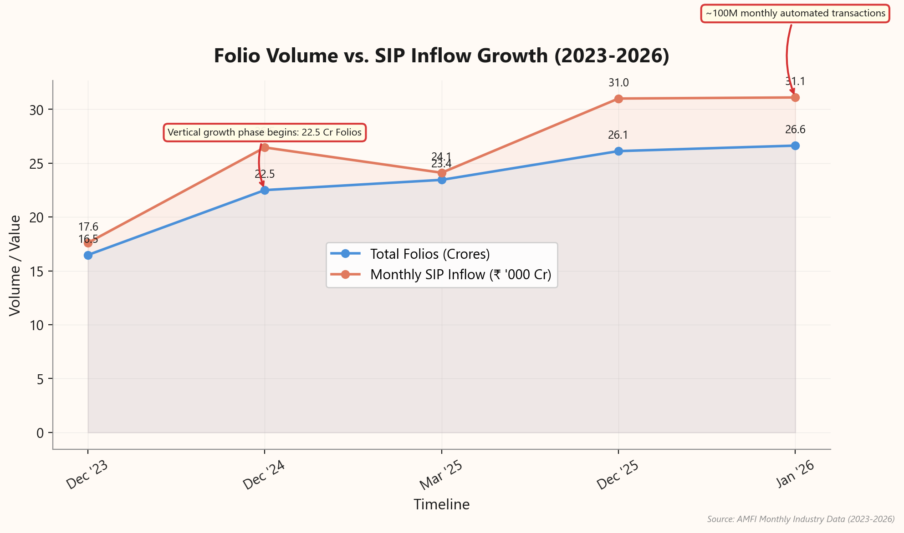
Automate Operations to Mitigate Folio Volume Liability
▸ Folio count surged to 26.63 crore in 2026, creating vertical operational growth.
▸ Monthly SIP inflows crossed ₹31,000 crore, triggering ~100 million automated transactions.
▸ Investors now hold 3.5 to 4 folios on average, complicating portfolio tracking.
▸ Average distributor manages ~1,317 distinct folios, making manual reconciliation mathematically impossible.
▸ Non-digitized operations face direct regulatory liability for service deficiencies under SEBI norms.
★ KEY INSIGHT: Manual tracking of 26+ crore folios creates unsustainable operational density and regulatory liability risks.
Client Databases: The Invisible Engine Behind Scal...
Slide 6 of 7

Slide 7
Adopt the Invisible Engine to Capture ₹100T Growth
▸ **Summary**: Tech adoption delivers higher margins, time savings, and scalable volume.
▸ **Recommendation**: Audit current CRM capabilities immediately to identify operational bottlenecks.
▸ **Goal**: Prepare infrastructure today to manage 2030's projected ₹100 Trillion volume.
▸ **Context**: 61.4% retail AUM share demands digital-first, high-volume service models.
Growth Metric | Current Statistic | Strategic Implication
Market Projection | ₹100 Trillion AUM by 2030 | Volume requires automated scalability
SIP Velocity | ₹26,459 Cr Monthly Inflows | High frequency demands zero-touch processing
Retail Dominance | 61.4% of Total AUM | Service model must be digital-first
Digital Adoption | 99.7% of Payment Volumes | Infrastructure must be fully cashless
Source: Axis Capital (2024), AMFI (Dec 2024), RBI Payment Report (2024)
★ KEY INSIGHT: Adopt the 'Invisible Engine' to secure your share of the ₹100 Trillion market.
Client Databases: The Invisible Engine Behind Scal...
Slide 7 of 7

